Slide 1
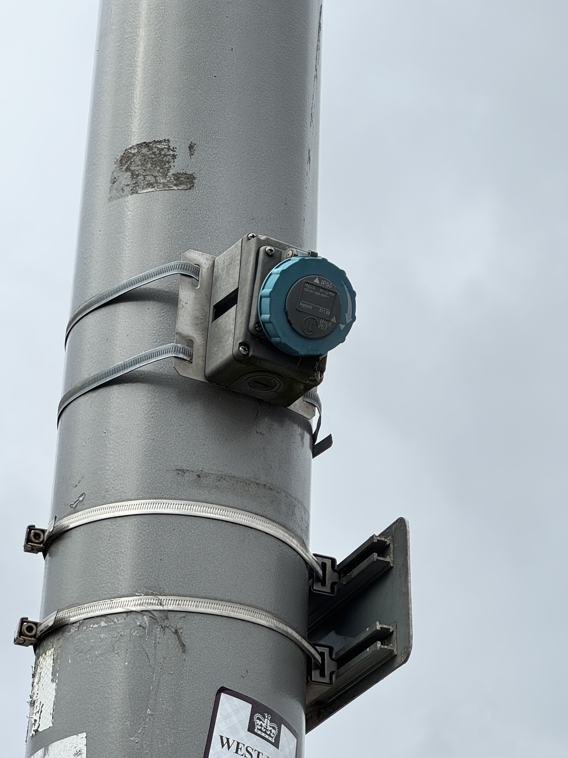
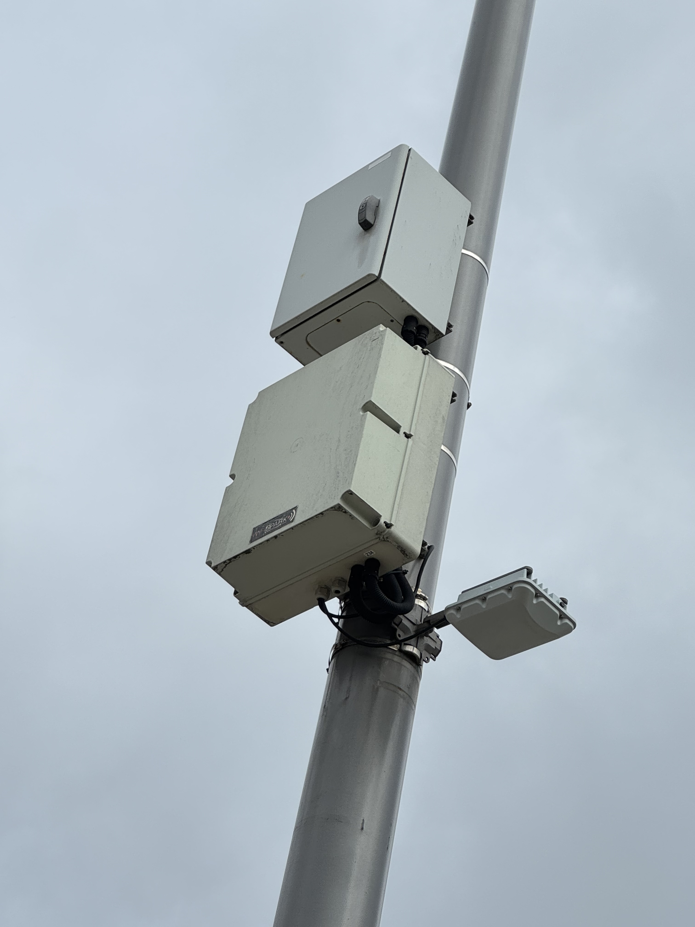
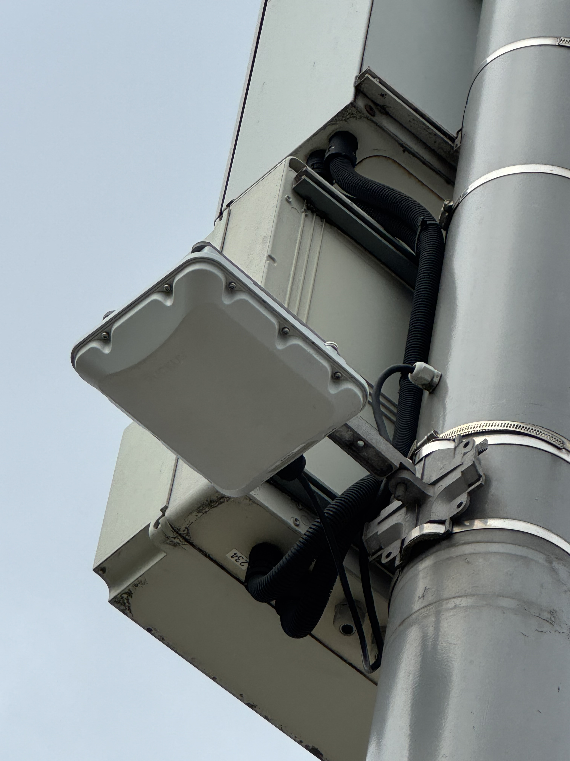
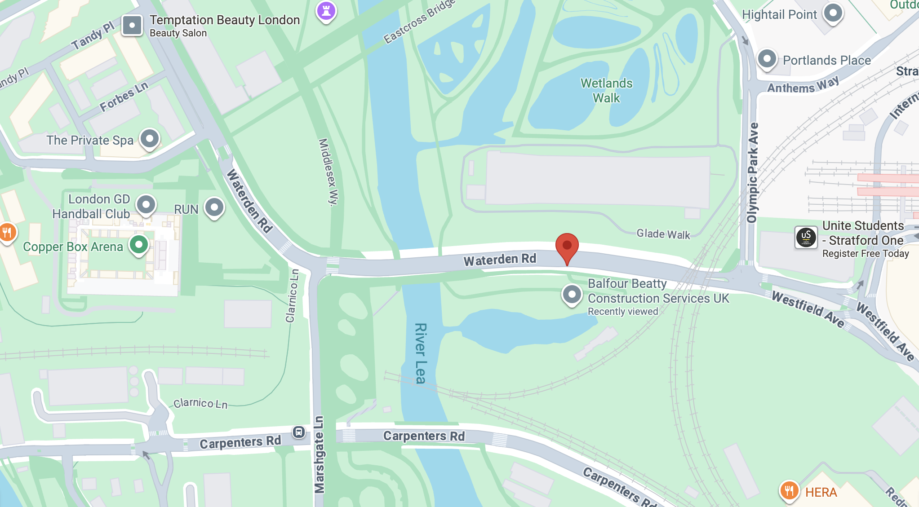
Public WiFi Access Point
Or IoT Gateway.
The IoT device I found consisted of three white boxes connected with each other. Below the white boxes, there was an industrial power socket that was not directly connected to the white boxes.
The white box at the bottom left has a label showing “WiFi Spark.” WiFi Spark is a company that provides public Wi-Fi access and smart city connectivity solutions. Also, the CCTV example we saw in Olympic Park had a same white box as the one at bottom right in the front picture. Therefore, these devices may be a public WiFi access point or a communication gateway that allows sensors or cameras to send data to the cloud.
Behind
Front
Questions when visiting site?
What is the box on the top used for? Power?
Is that a WiFi access point or a gateway for data transaction?
Does the industrial power socket have any relationship with the IoT device?
Location info:
@51.5442516,-0.0147843
Waterden Rd, London, E20 1DR
https://maps.app.goo.gl/PviKY2cRv9ATZUZK9?g_st=ipc
what3words: ///prop.nasal.medium
Submitted: Annie Zhu Oct 2025

